Slide 1







Slide 2
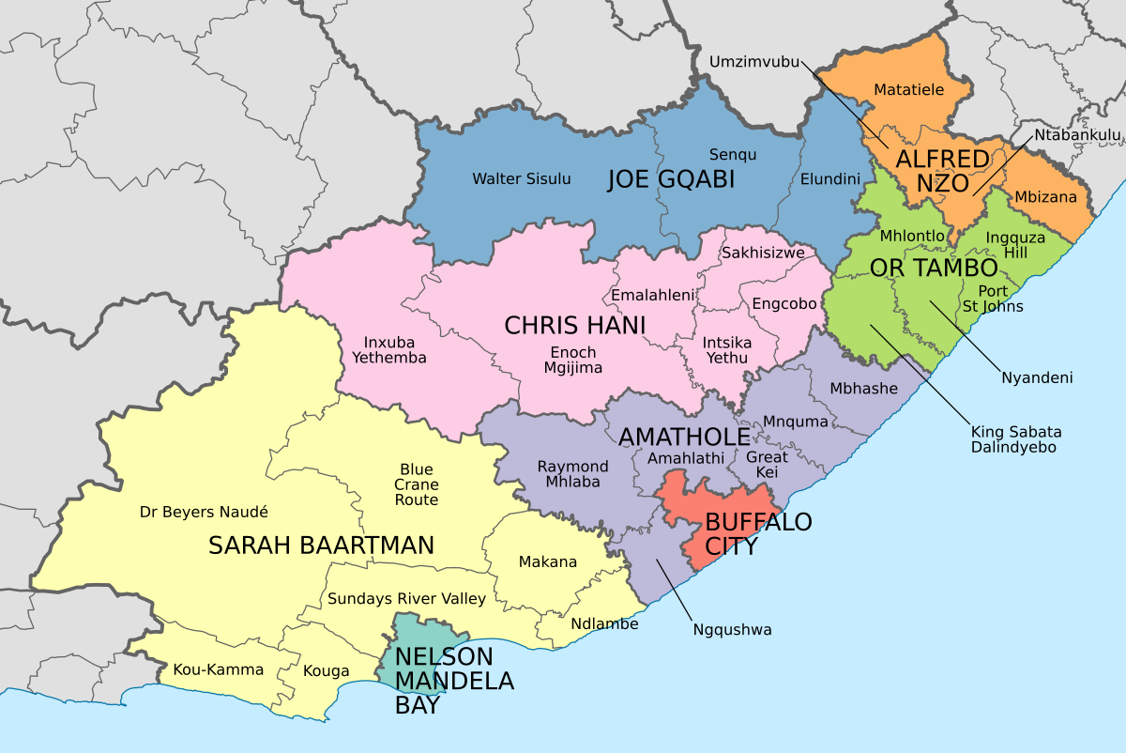
Sarah Baartman District Municipality

Slide 3
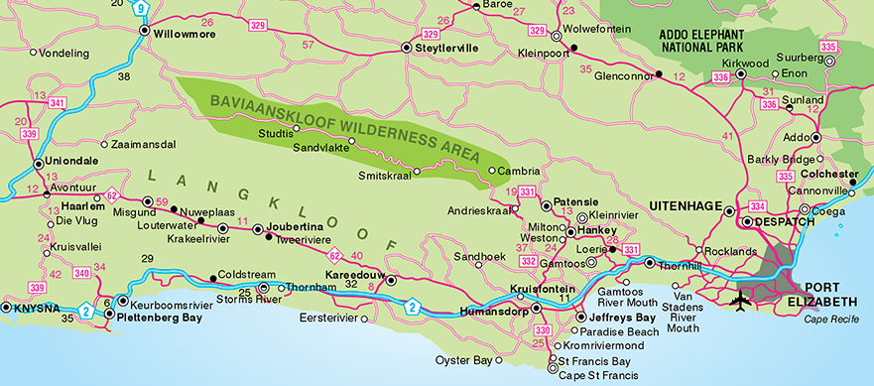

Slide 4
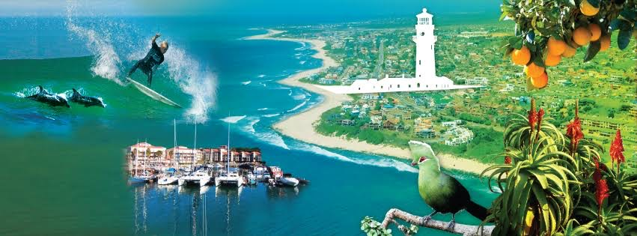
Kouga Tourism Routes
- Jeffrey’s Bay - Greater St Francis -
- Gamtoos Valley -

Slide 5
Access Routes to Gamtoos Valley
Via N2 national highway from Port Elizabeth
80 – 100km from Port Elizabeth – 1 hour driving time
Via N2 national highway from the Garden Route
138km from Plettenberg Bay – 2 hours driving time
Via Baviaanskloof (Willowmore side) – overland 4x4 drive – approximately 6 hour drive

Slide 6

Gamtoos Valley is the
Eastern Gateway to the Baviaanskloof
and, also known as the
Fruit Basket of the Eastern Cape
Promoting tourism into
Baviaanskloof / Patensie / Hankey / Loerie / Thornhill

Slide 7
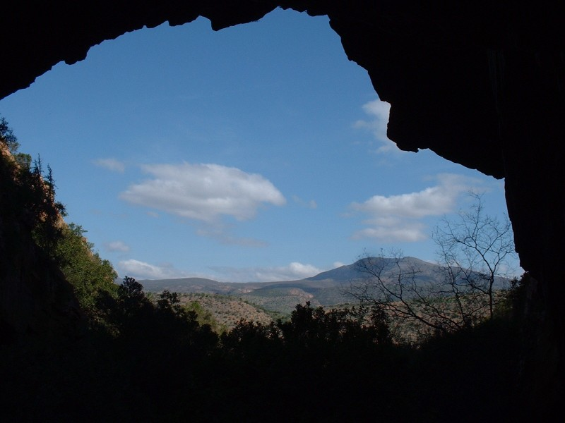
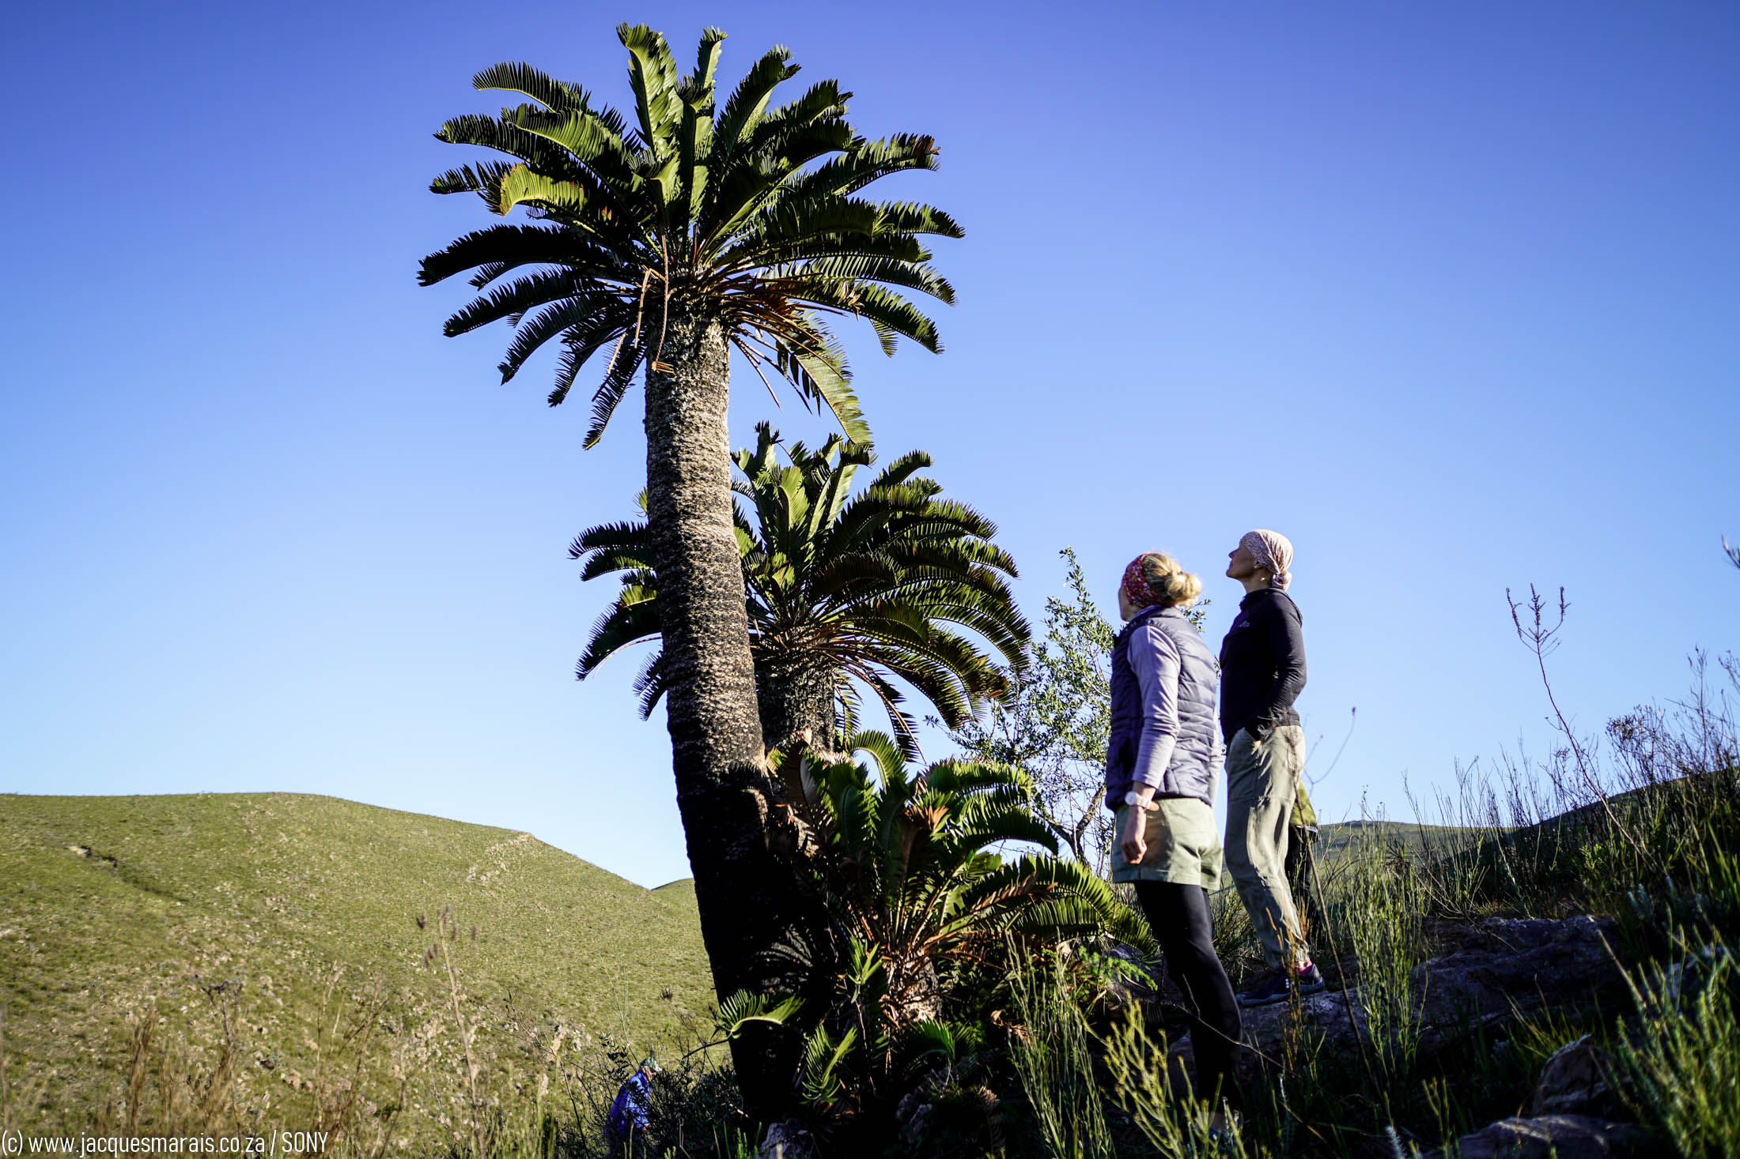
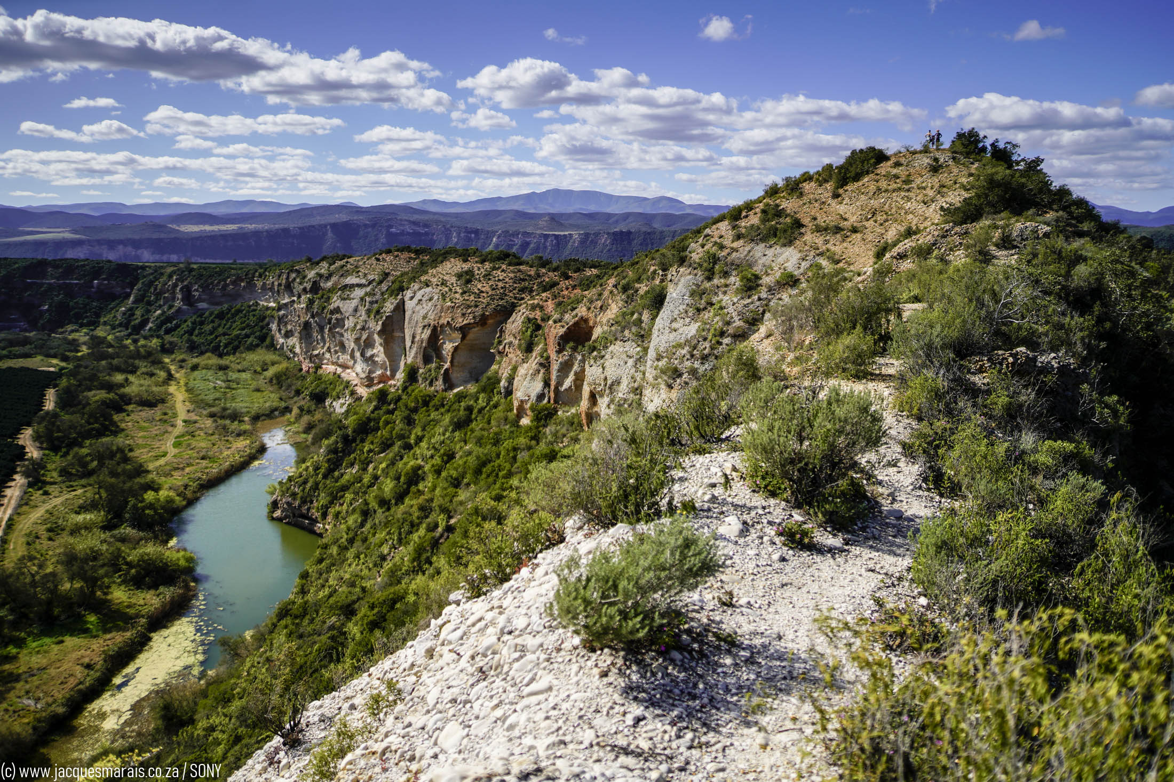
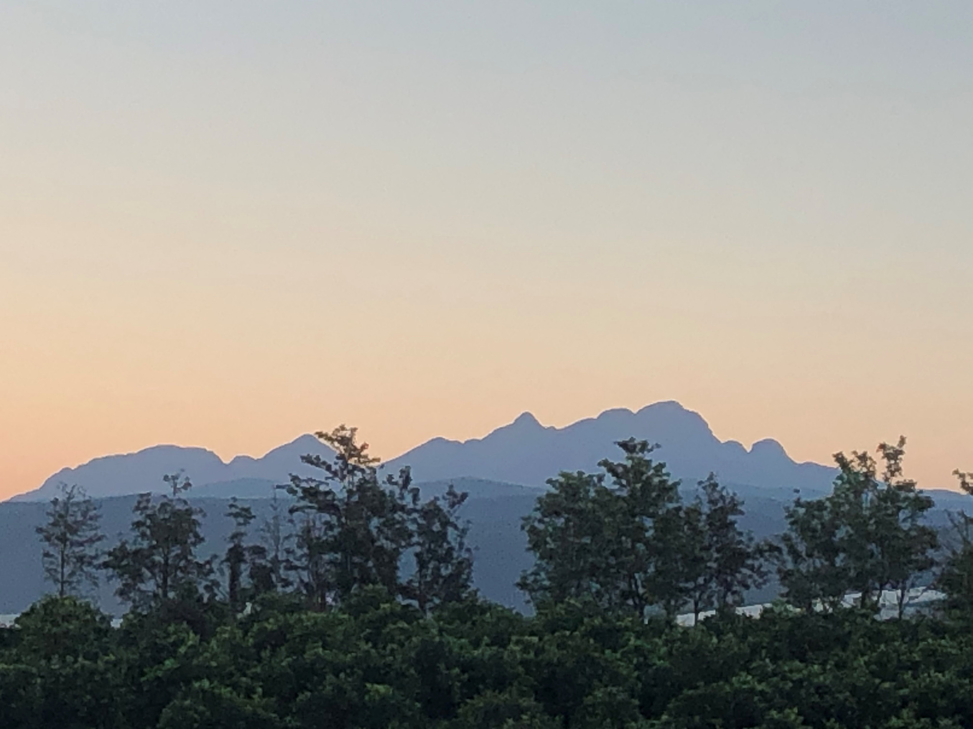
Rich in unspoilt and superb scenery
Somewhat off the beaten track

Slide 8
Variety of interesting places to visit
and things to do in the
Gamtoos Valley that stretches over 70km
before you enter the
Baviaanskloof World Heritage Site.

Slide 9
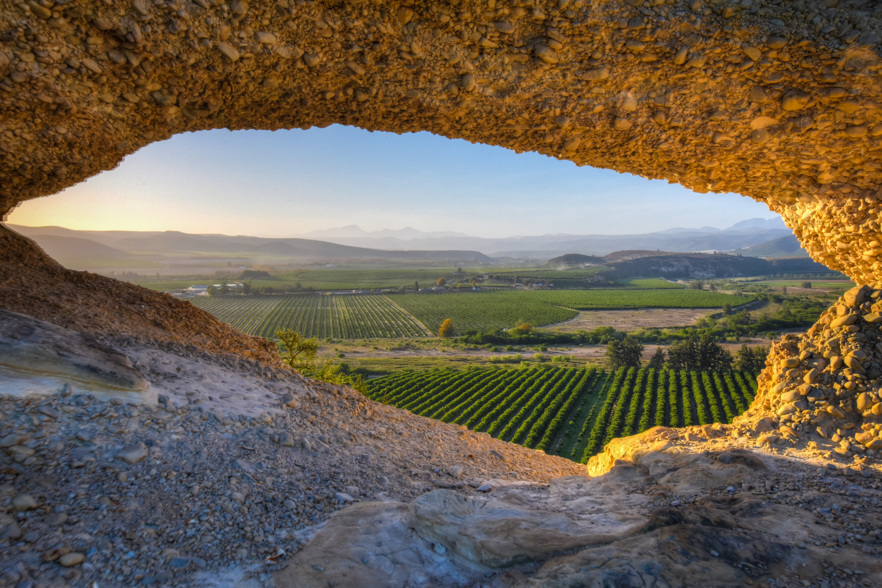
Bergvenster overlooking citrus orchards towards Patensie

Slide 10
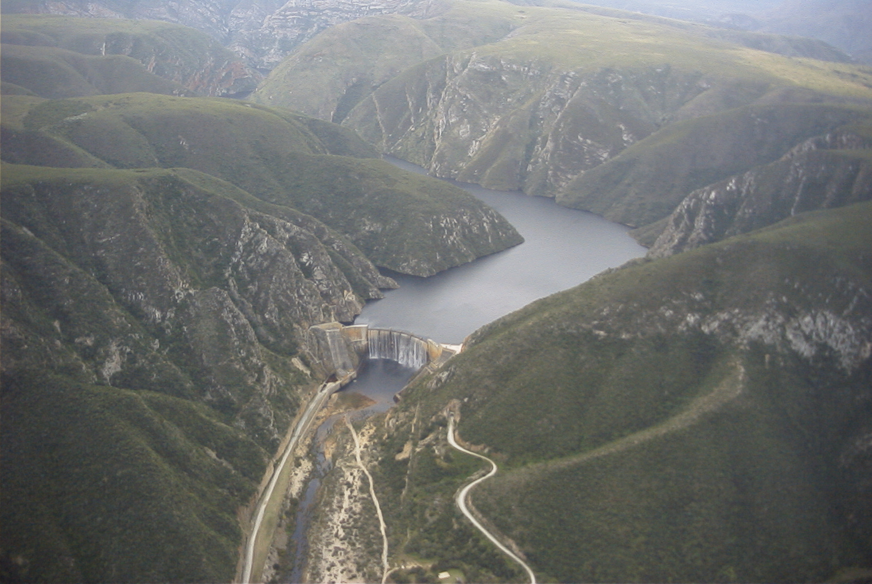
Kouga Dam
Kouga means “Hippopotamus”
It is the First Double Arched dam
engineered in South Africa
Catchment Area : 388 700ha
Length of dam basin: 34km
Surface area (full) : 555ha
Total capacity : 133 million m³
Height : 94.5m
Maximum water depth : 53m
Maximum wall thickness : 10.2m
Dam capacity when full : 125.5 million m³

Slide 11
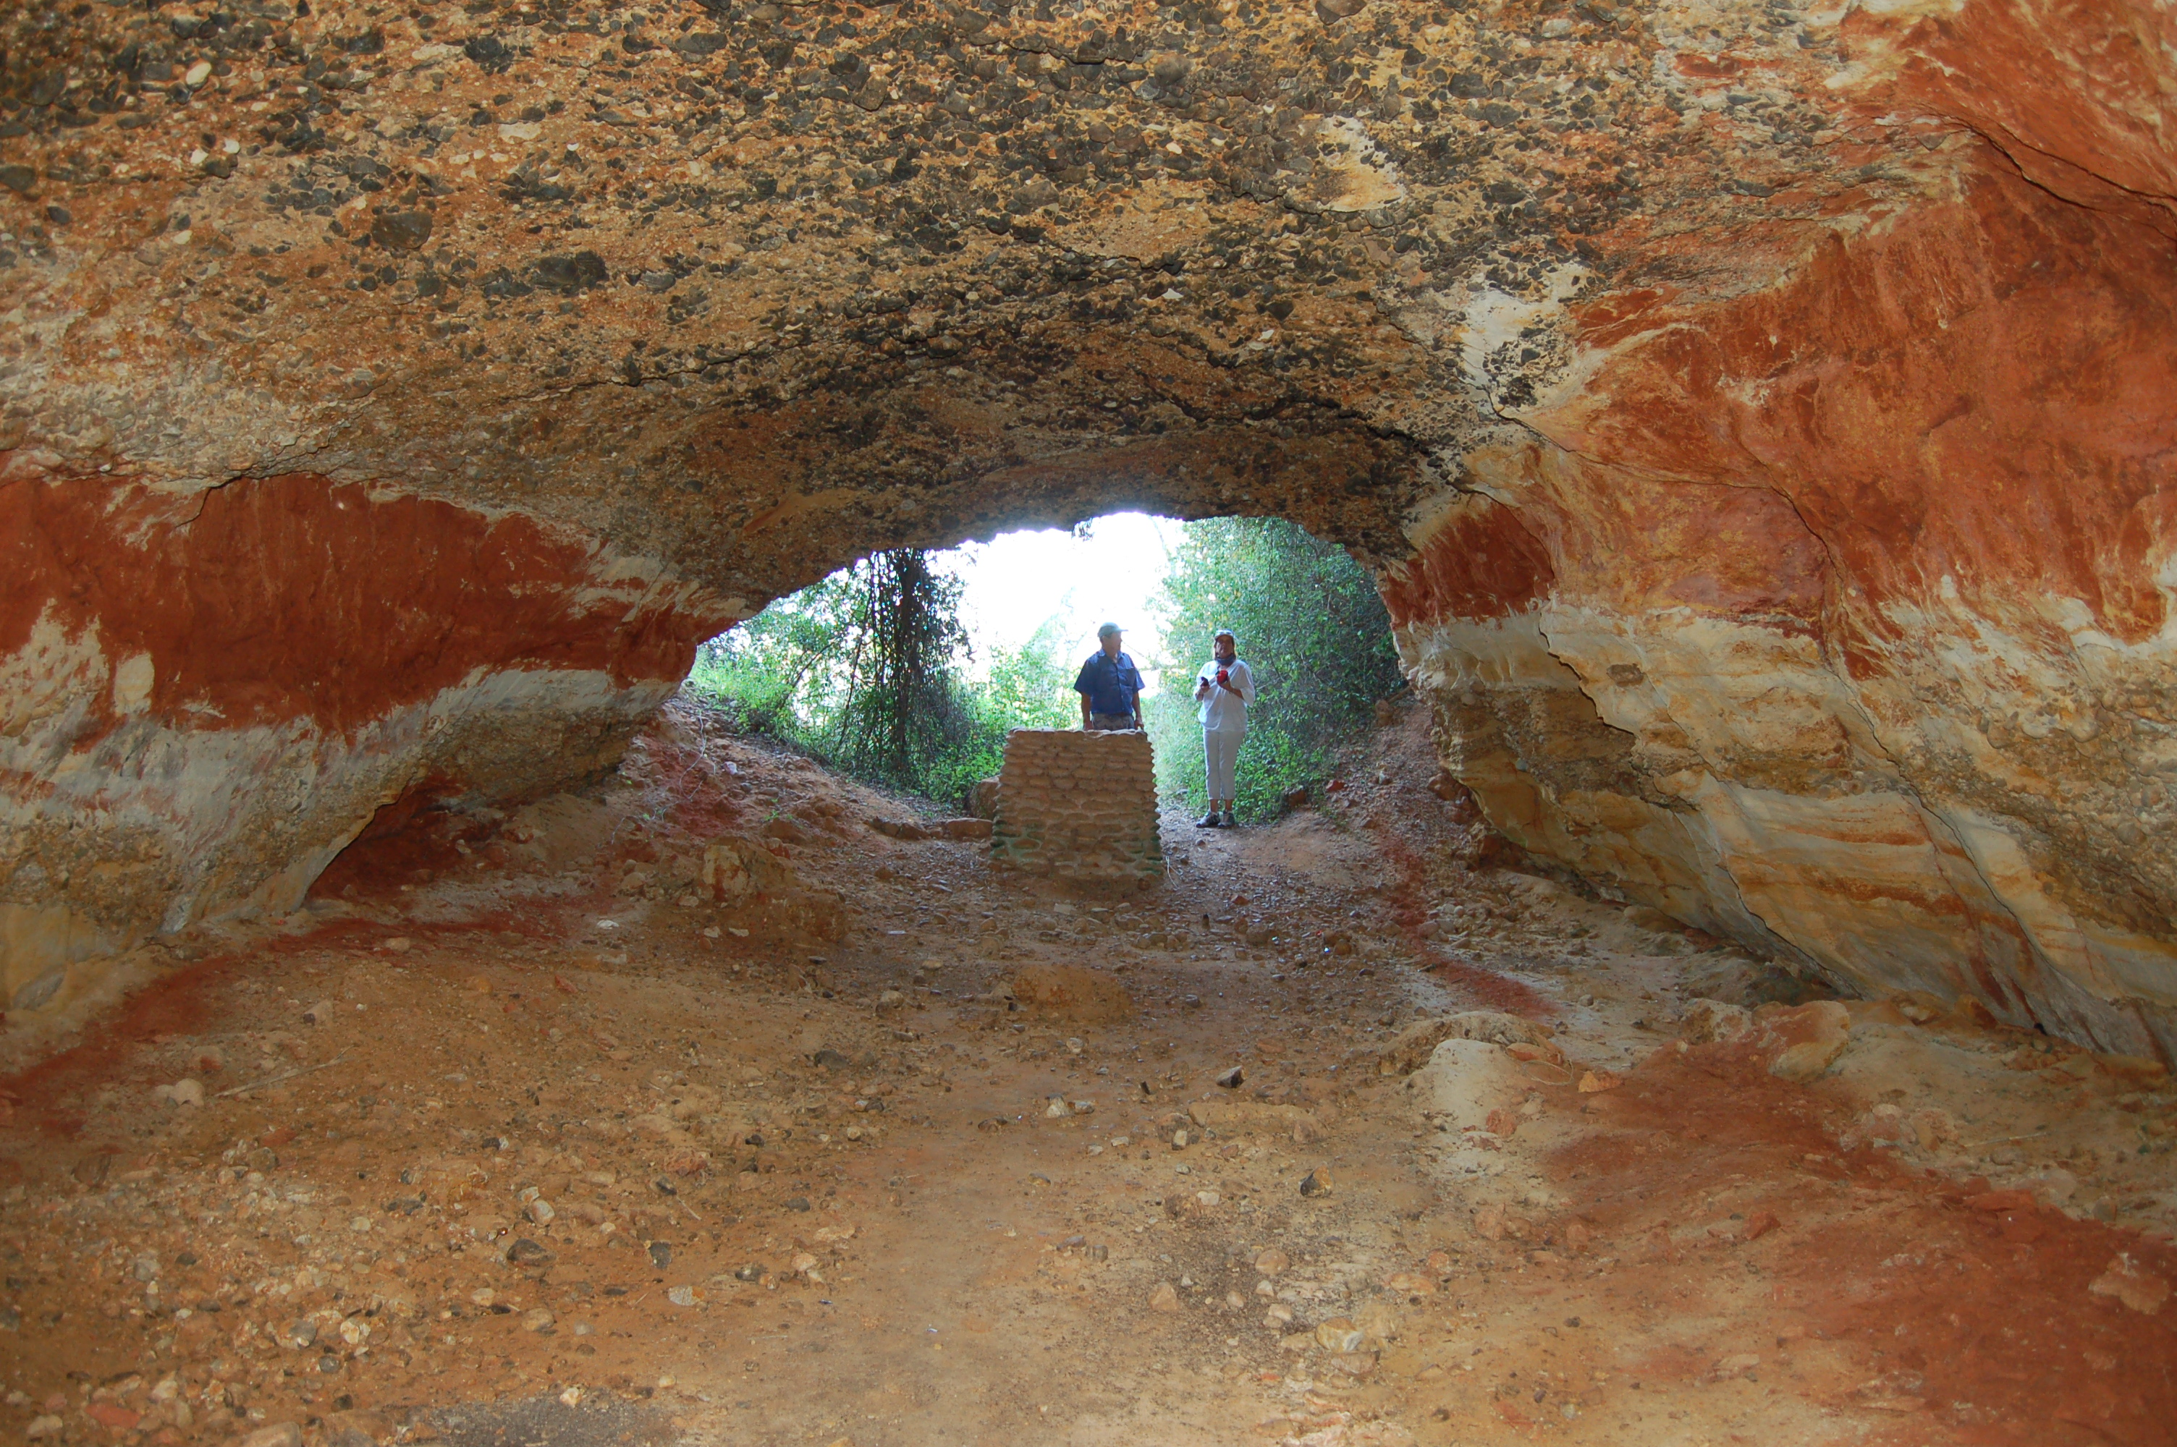
Philip Tunnel
First ever tunnel scheme in South Africa
Carried out by William Philip, using picks, shovels and wheelbarrows.
Length of tunnel was 228m. Completed in 1844. In use from 1845 - 1970

Slide 12
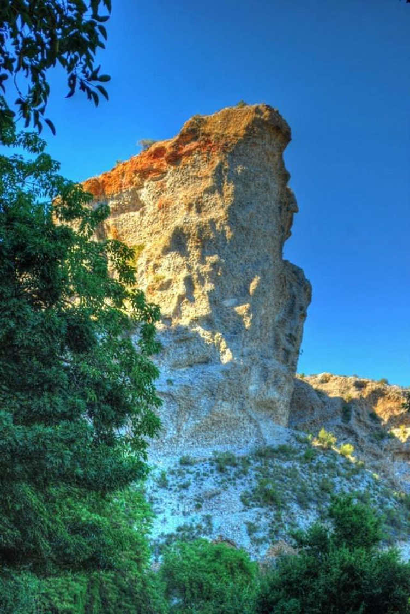
Queen Victoria’s Profile
Enon conglomerate rock formations.
A Geological miracle

Slide 13



Agri Tourism
Strawberry pick-your-own experience in season
Honey Tasting
Honey & Bee-keeping Experience
Dragon Fruit picking in season
Blue Berries
Cucumbers in tunnels
Peppers in tunnels
Citrus experience in season
Olive Oil tasting in the Baviaanskloof

Slide 14
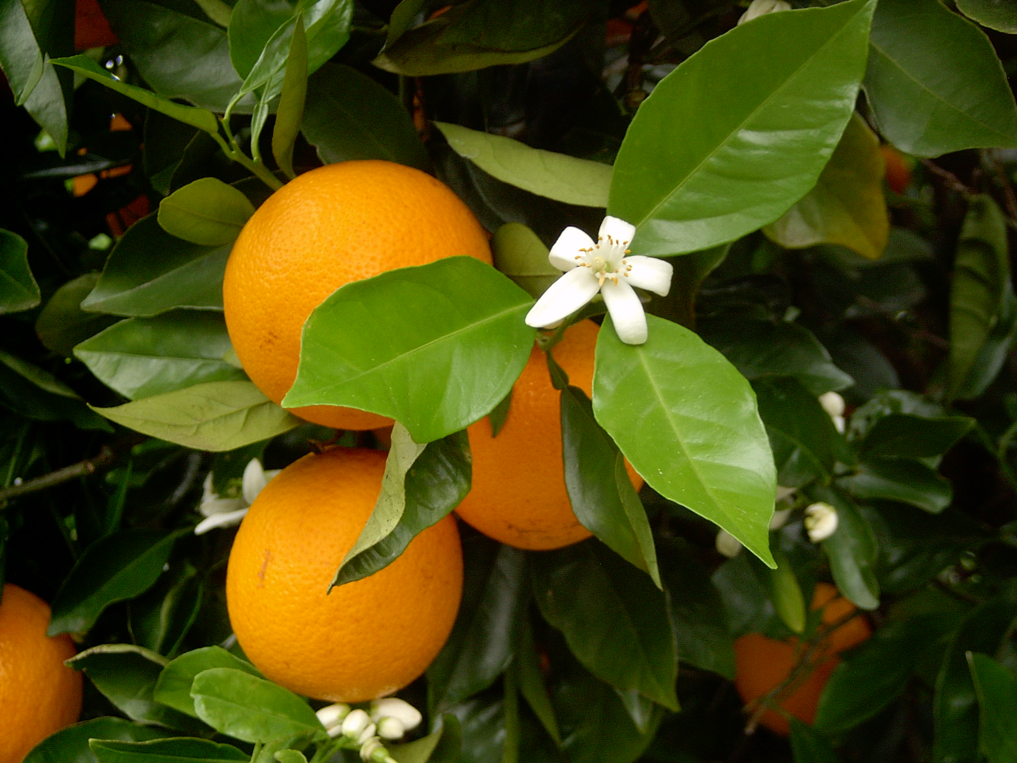
Citrus Harvesting season: April to October

Slide 15
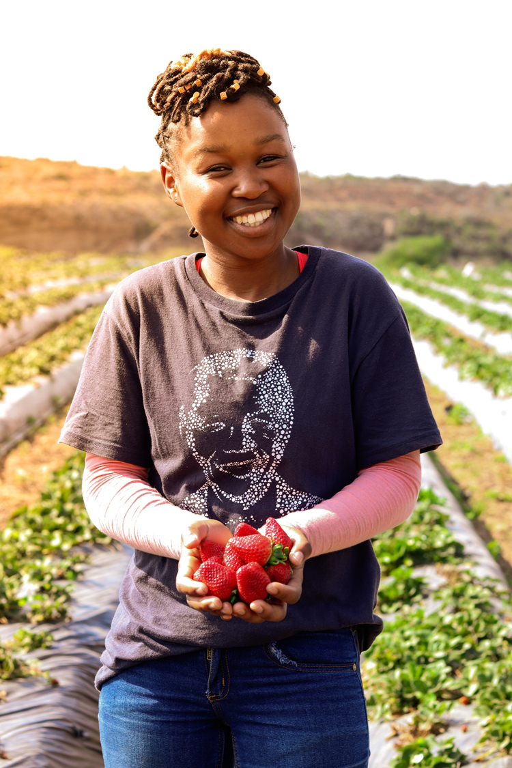

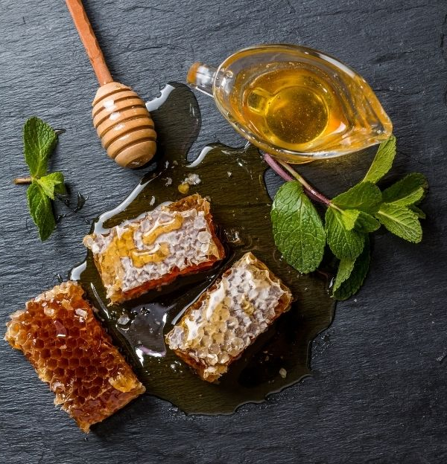

Agri Tourism

Slide 16
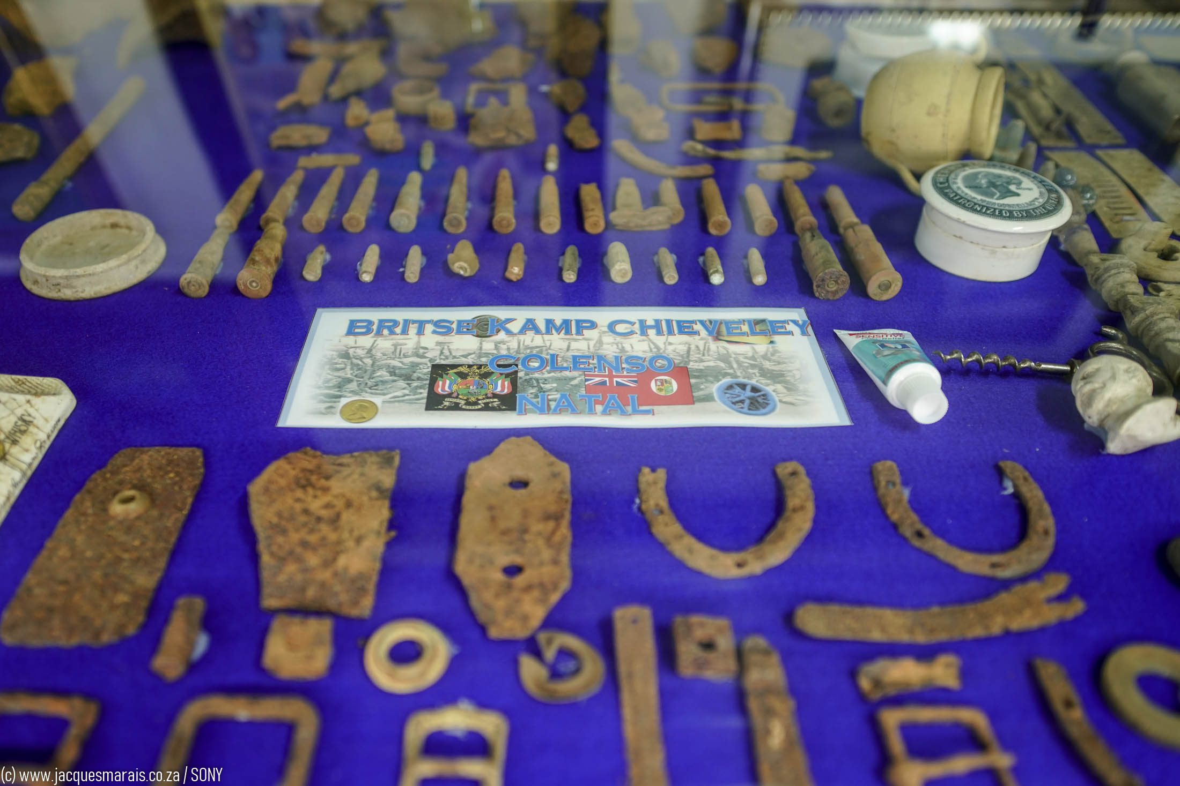
Mount Ingwe Anglo Boer War Relics Museum

Slide 17

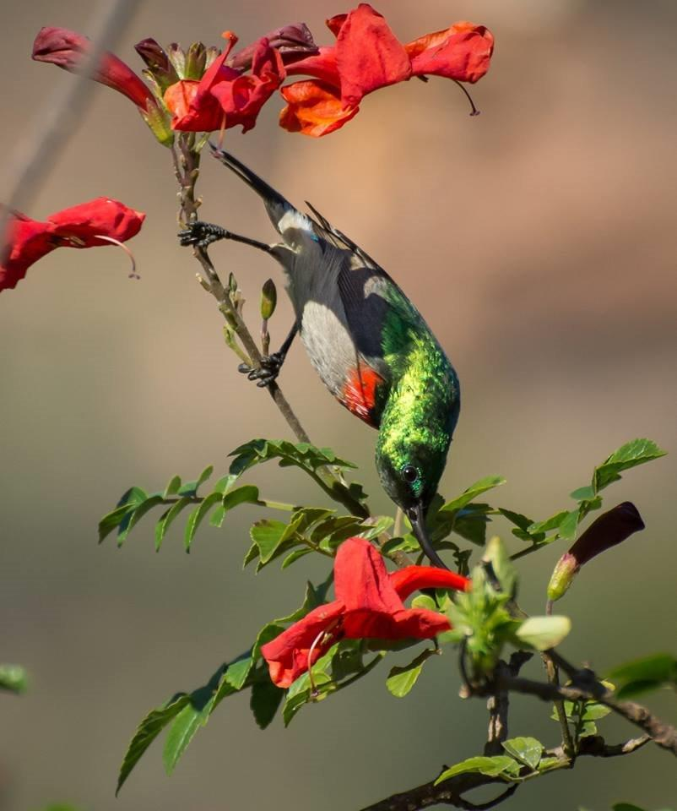
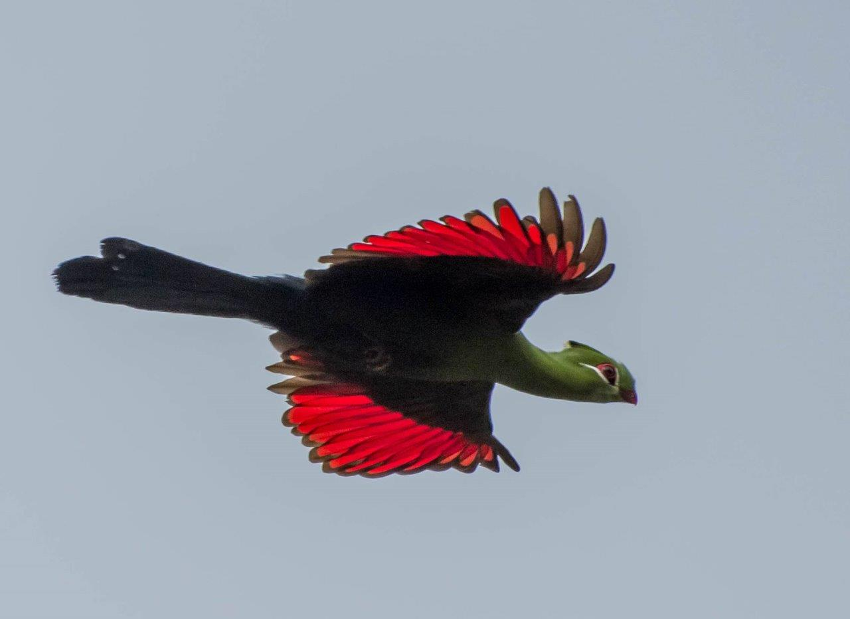
Birdwatching paradise
#ExperiencesNotThings

Slide 18
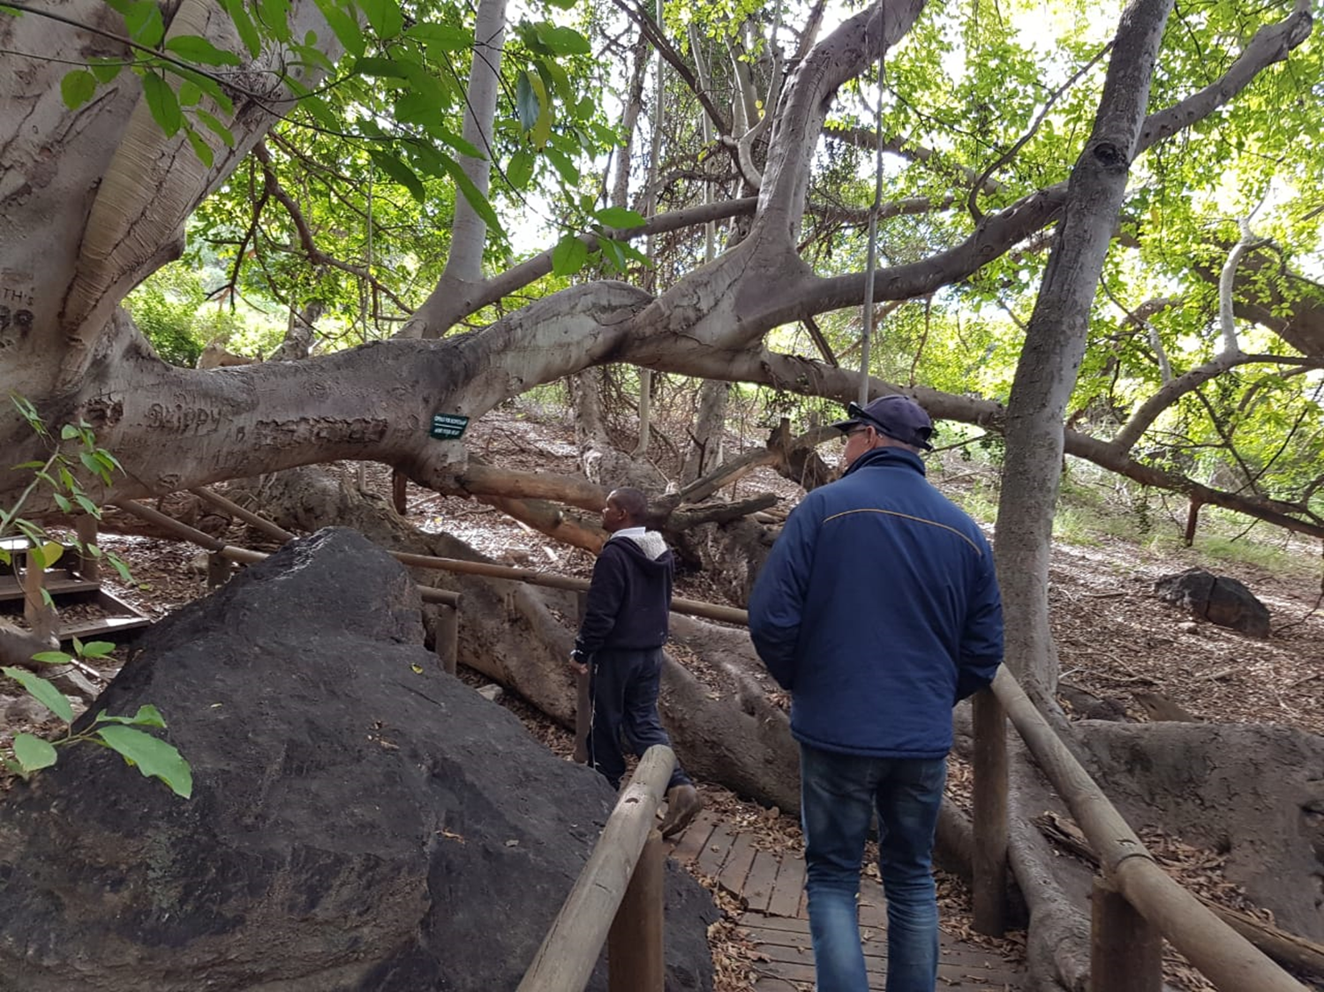
Wild Fig Tree Forest, Baviaanskloof

Slide 19
Activities / Adventures
Game Drives (Guided & Self-drive)
4x4 Routes
Hiking Trails & Nature Walks
Mountain Biking
Kayaking (Extreme & Social)
Stargazing whilst camping
Agri Tourism (Citrus, Strawberries, Honey, Olives, Peppers, Cucumbers, Dragon Fruit etc)
Birdwatching
Cave camping in the Baviaanskloof
Golfing (Hankey 9-hole golf course)
Fishing

Slide 20
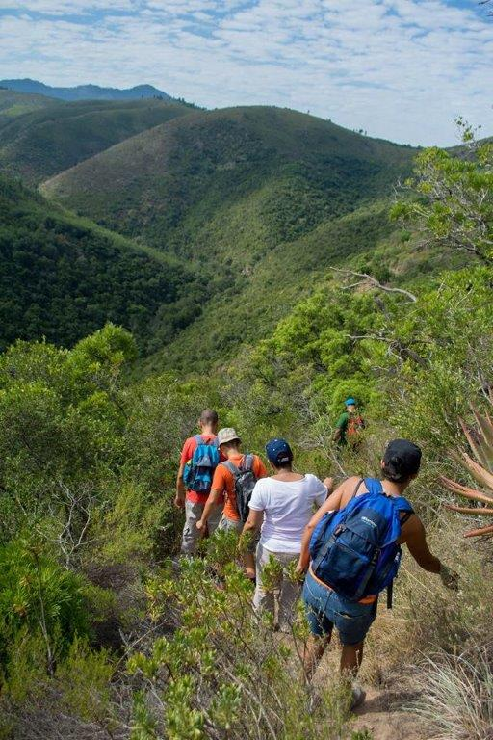
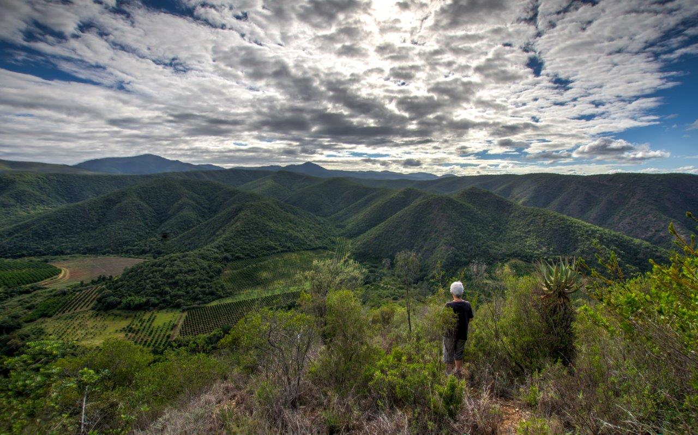
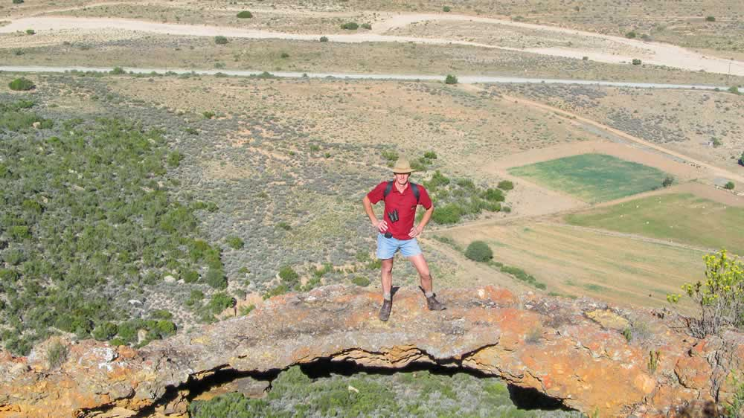
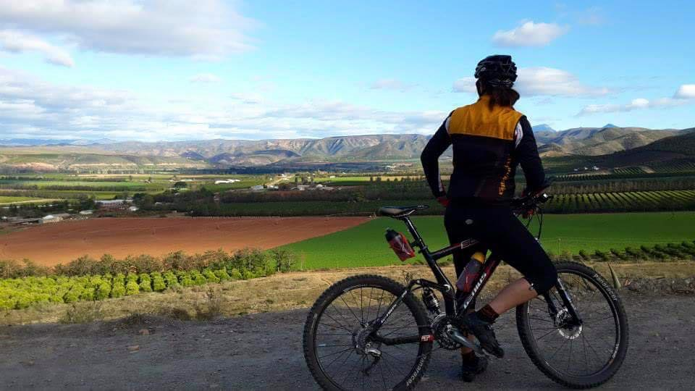
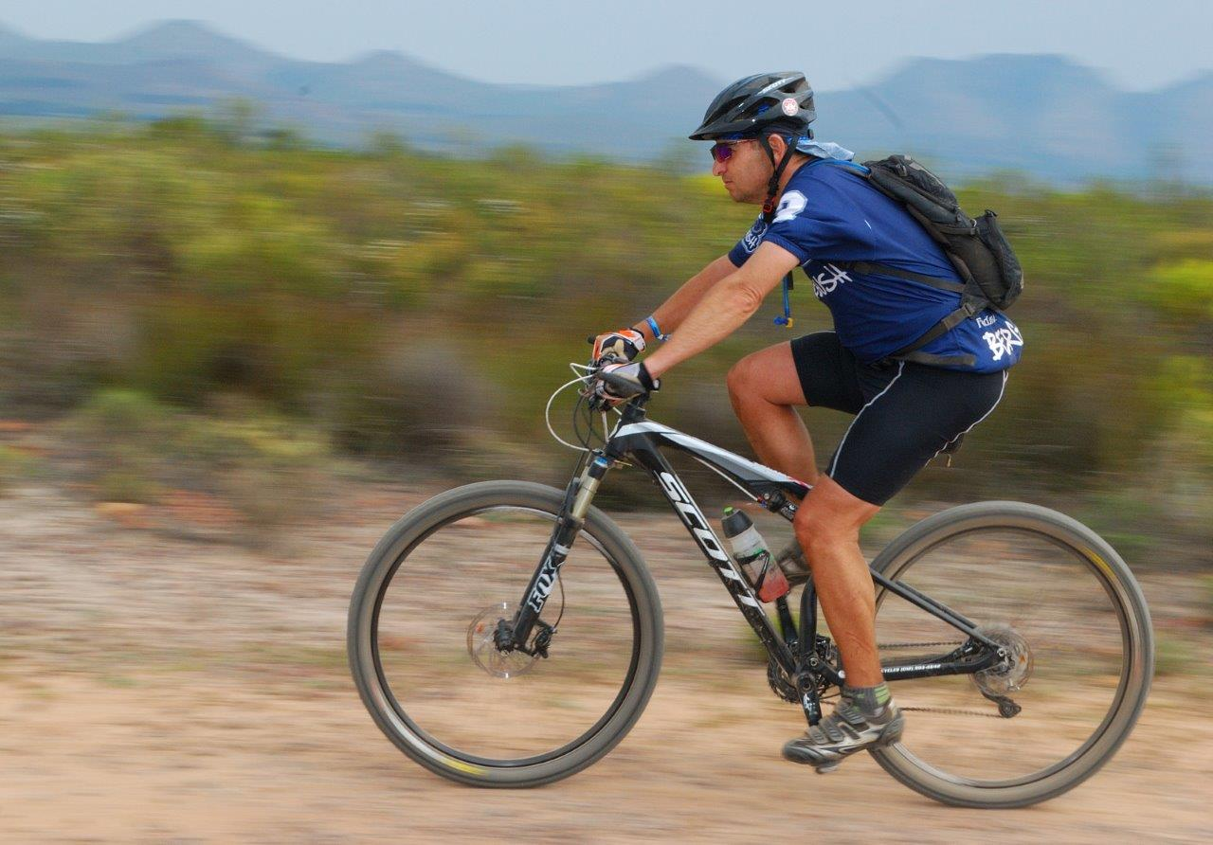
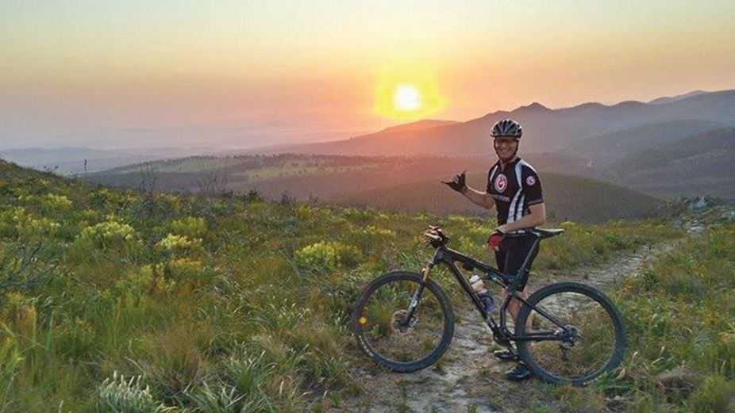
Hiking & MTB trails
#BeFree

Slide 21
3rivers trails is home to one of South Africa’s largest trail networks
…stretches over 200km
…Mountain biking,
…trail running,
…hiking…
You get to choose!

Slide 22

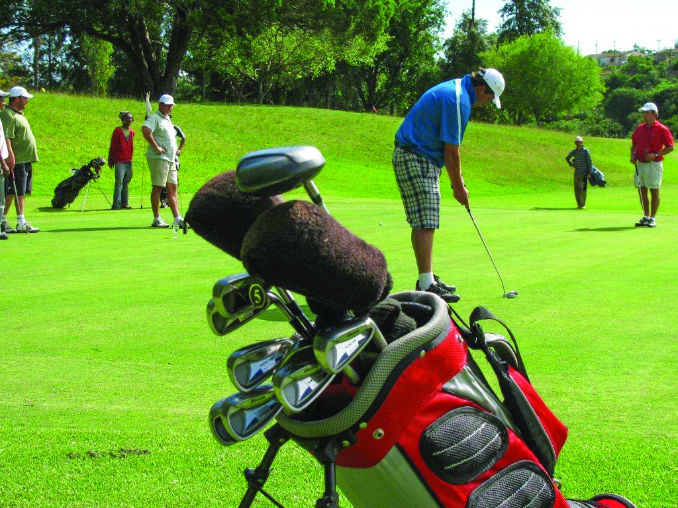
Golf Tourism
Hankey Golf Club – 9-hole golf course

Slide 23
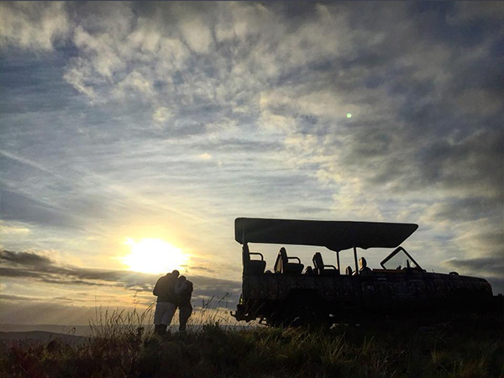
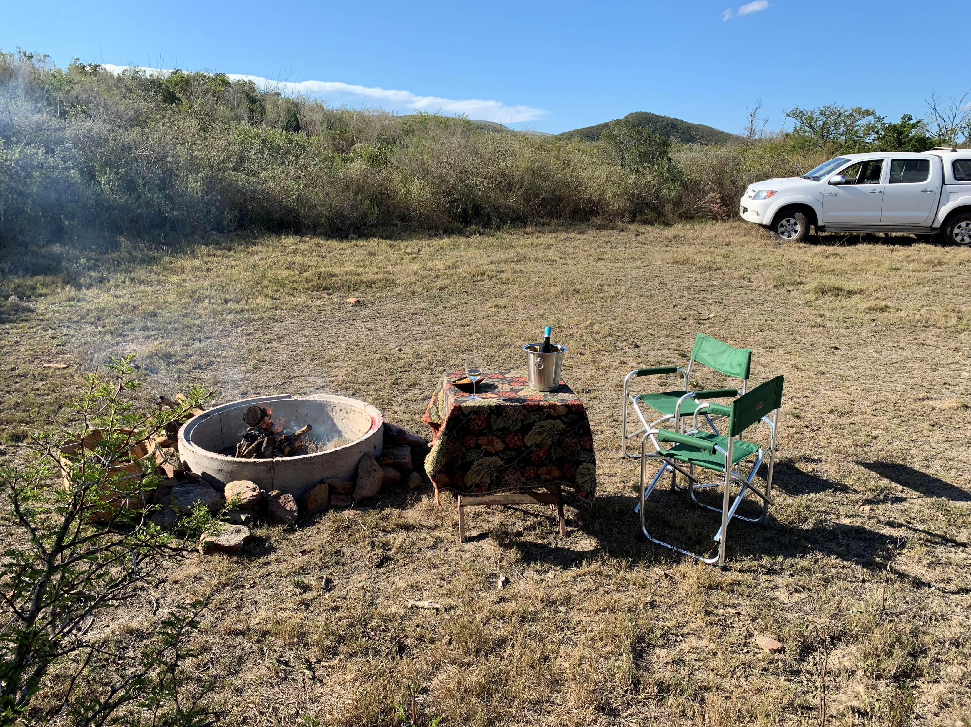
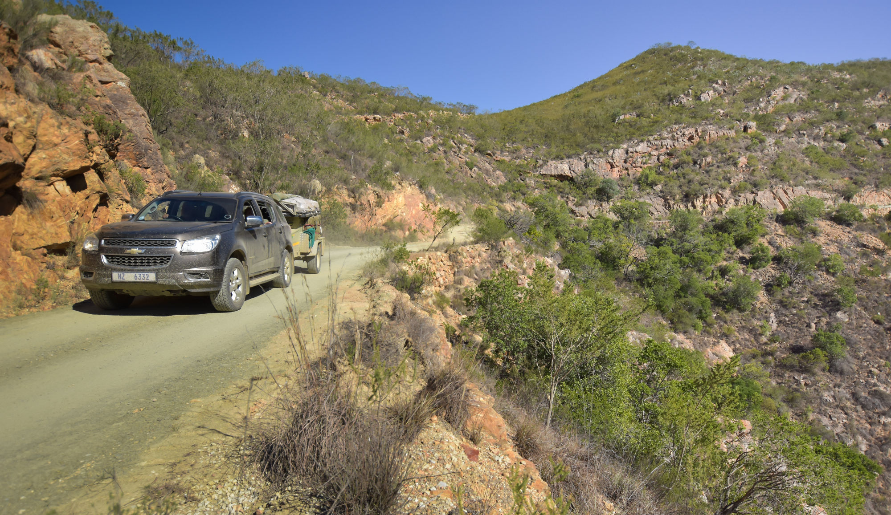
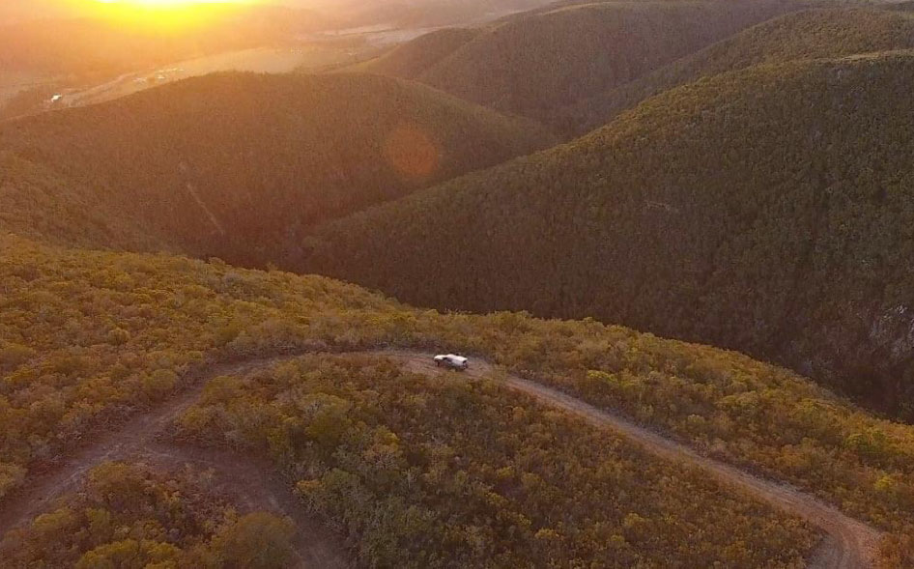
4x4 routes

Slide 24
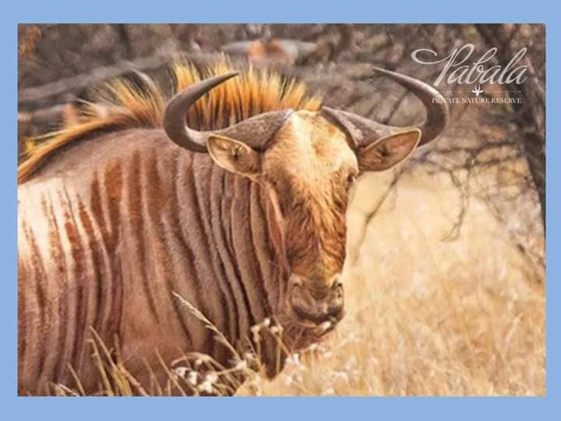
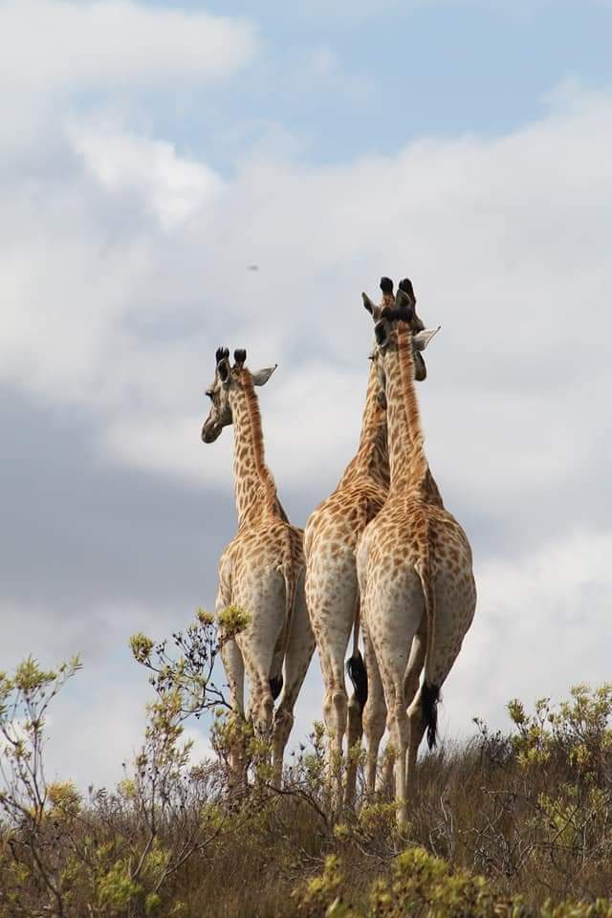
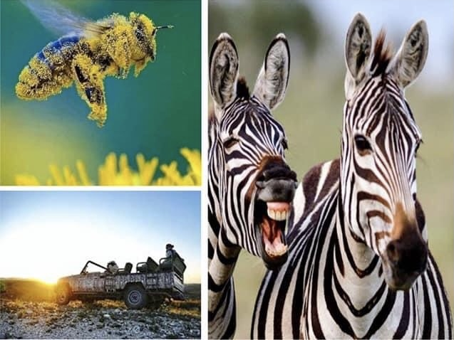
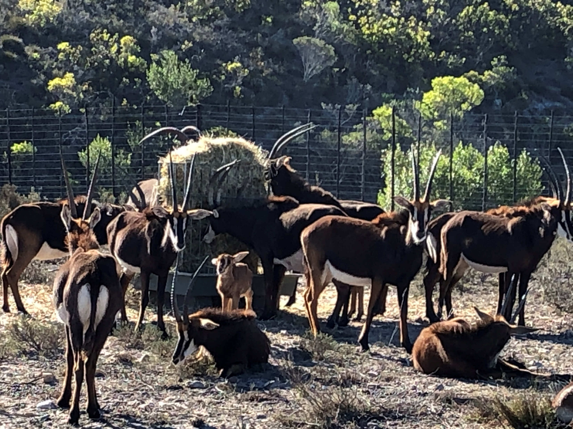
Game Viewing

Slide 25
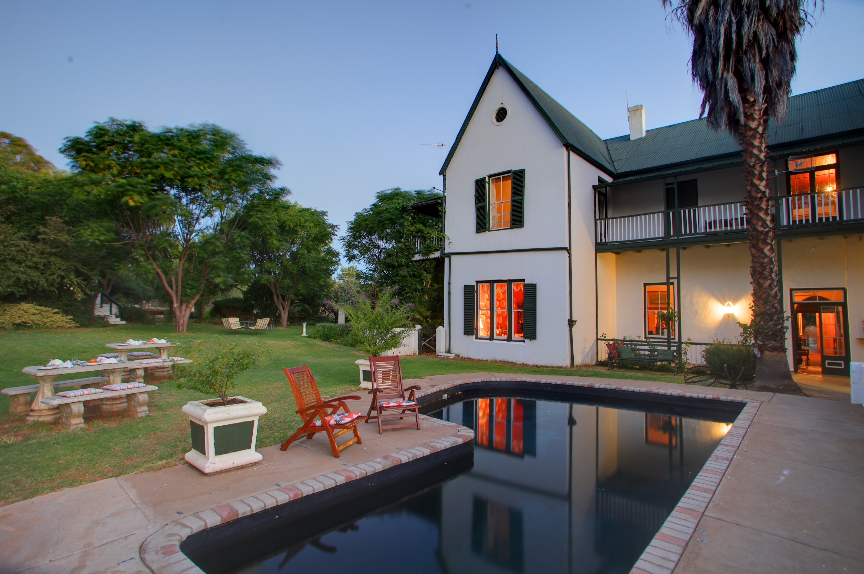
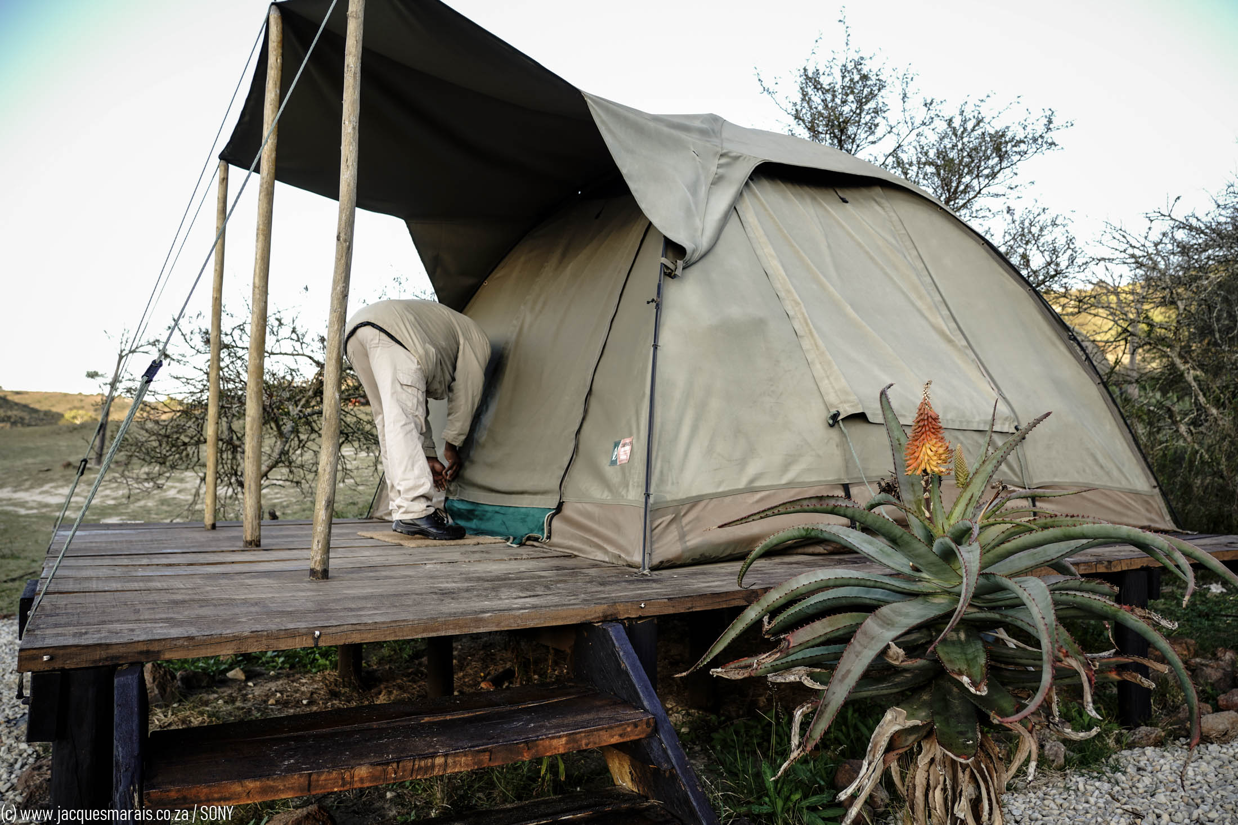
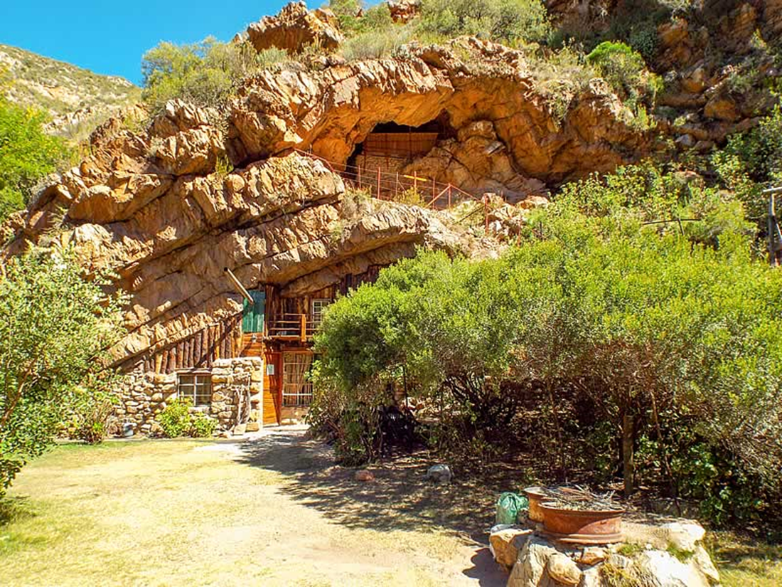
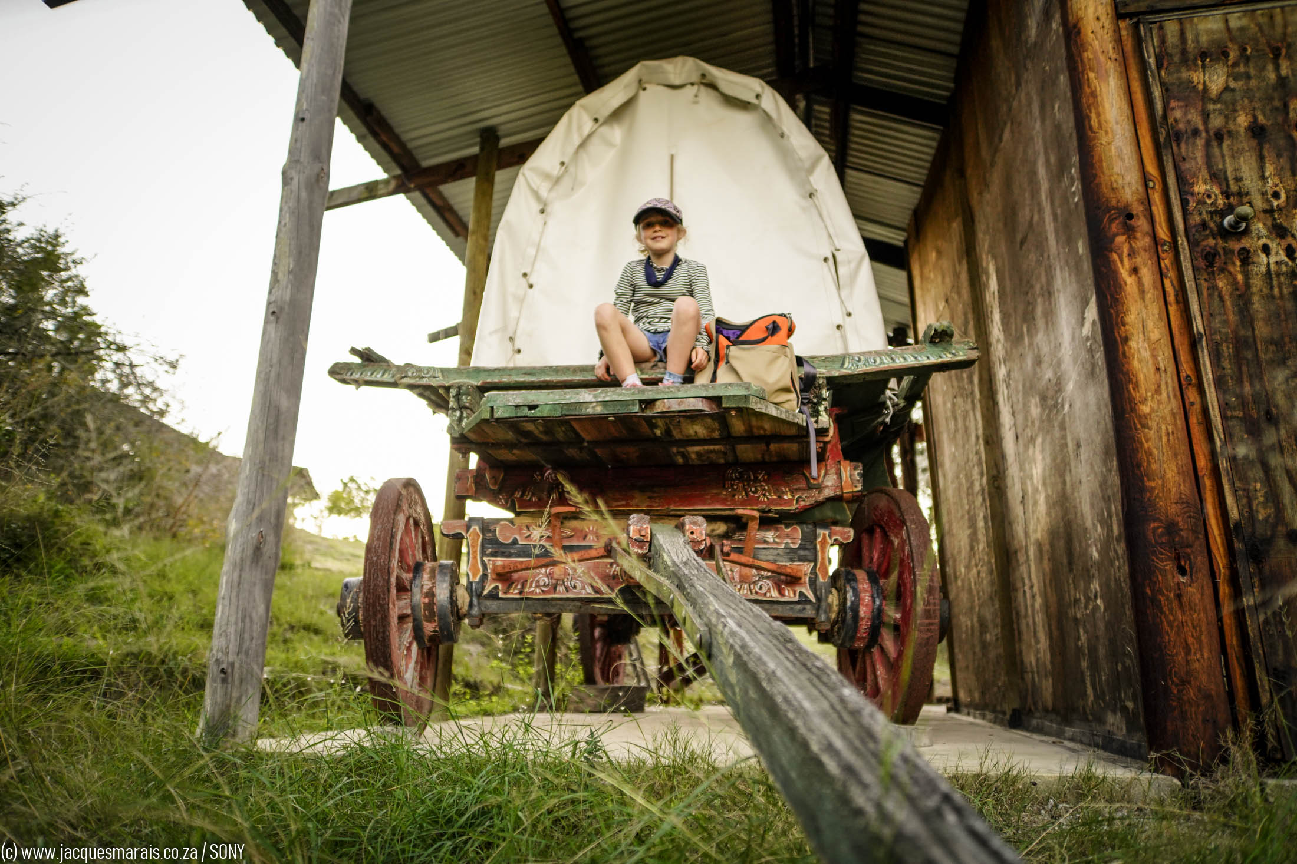
Great country style and farm-based accommodation
Self-catering
Bed & Breakfast
Tented Camp
Campsites
Chalets
Guest Houses
Ox-wagons
Caves
Tree House

Slide 26
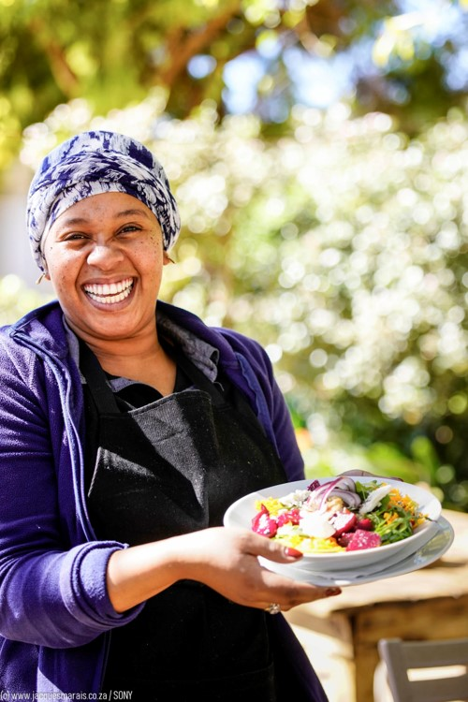
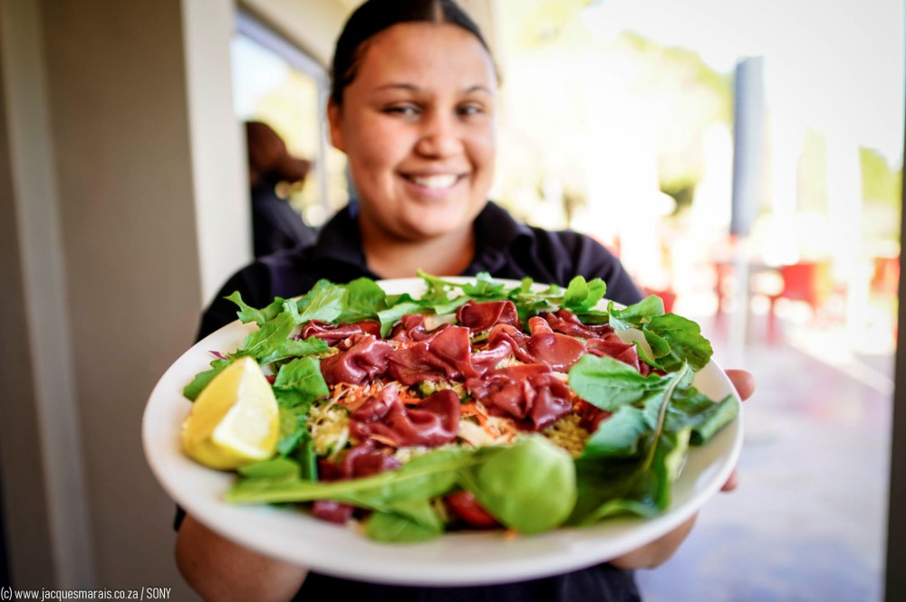
Culinary Tourism
Tolbos Country Shop & Restaurant
Padlangs Country Restaurant
BaviJaans Padstal

Slide 27

Gamtoos-Baviaans Experience Package
A great 4-day self-drive holiday
Day 1 - arrive and book into Archers Guesthouse in Patensie.
Day 2 - After a hearty breakfast at Tolbos, you can treat yourself to a guided drive (4 pax maximum) into the Baviaanskloof Wilderness Area with Guarri Safari, where you will enjoy a picnic at Bergplaas. Overnight self-catering accommodation at Windmill Guesthouse.
Day 3 - Breakfast the next morning can be joined at Padlangs. From there you can enjoy a farm visit at Mooihoek Strawberry Farm and proceed to Mount Ingwe Game Lodge for overnight self-catering accommodation and a visit to the Anglo Boer War Museum.
Day 4 - Off to Pabala Private Nature Reserve for an early morning game drive. From there you can visit Bergrivier Eco-retreat to enjoy one of the many hiking trails or just leisurely walk around on the farm. Overnight accommodation can be enjoyed in a restored ox-wagon (ossewa) if you wish to go back in time. There are cottages too.

Slide 28
2-day package visiting Gamtoos Valley
Day 1 - arrive early morning and enjoy breakfast at Padlangs, then depart for a citrus experience on one of the many farms in the valley. Accommodation at Tropical Eden Self-Catering Villas in Patensie.
Day 2 - After a hearty breakfast at Tolbos, treat yourself to a guided drive to Philip Tunnel and Mooihoek Strawberry Farm.
From here you can easily move onto St Francis and/or Jeffrey’s Bay to make your visit a memorable one!

Slide 29
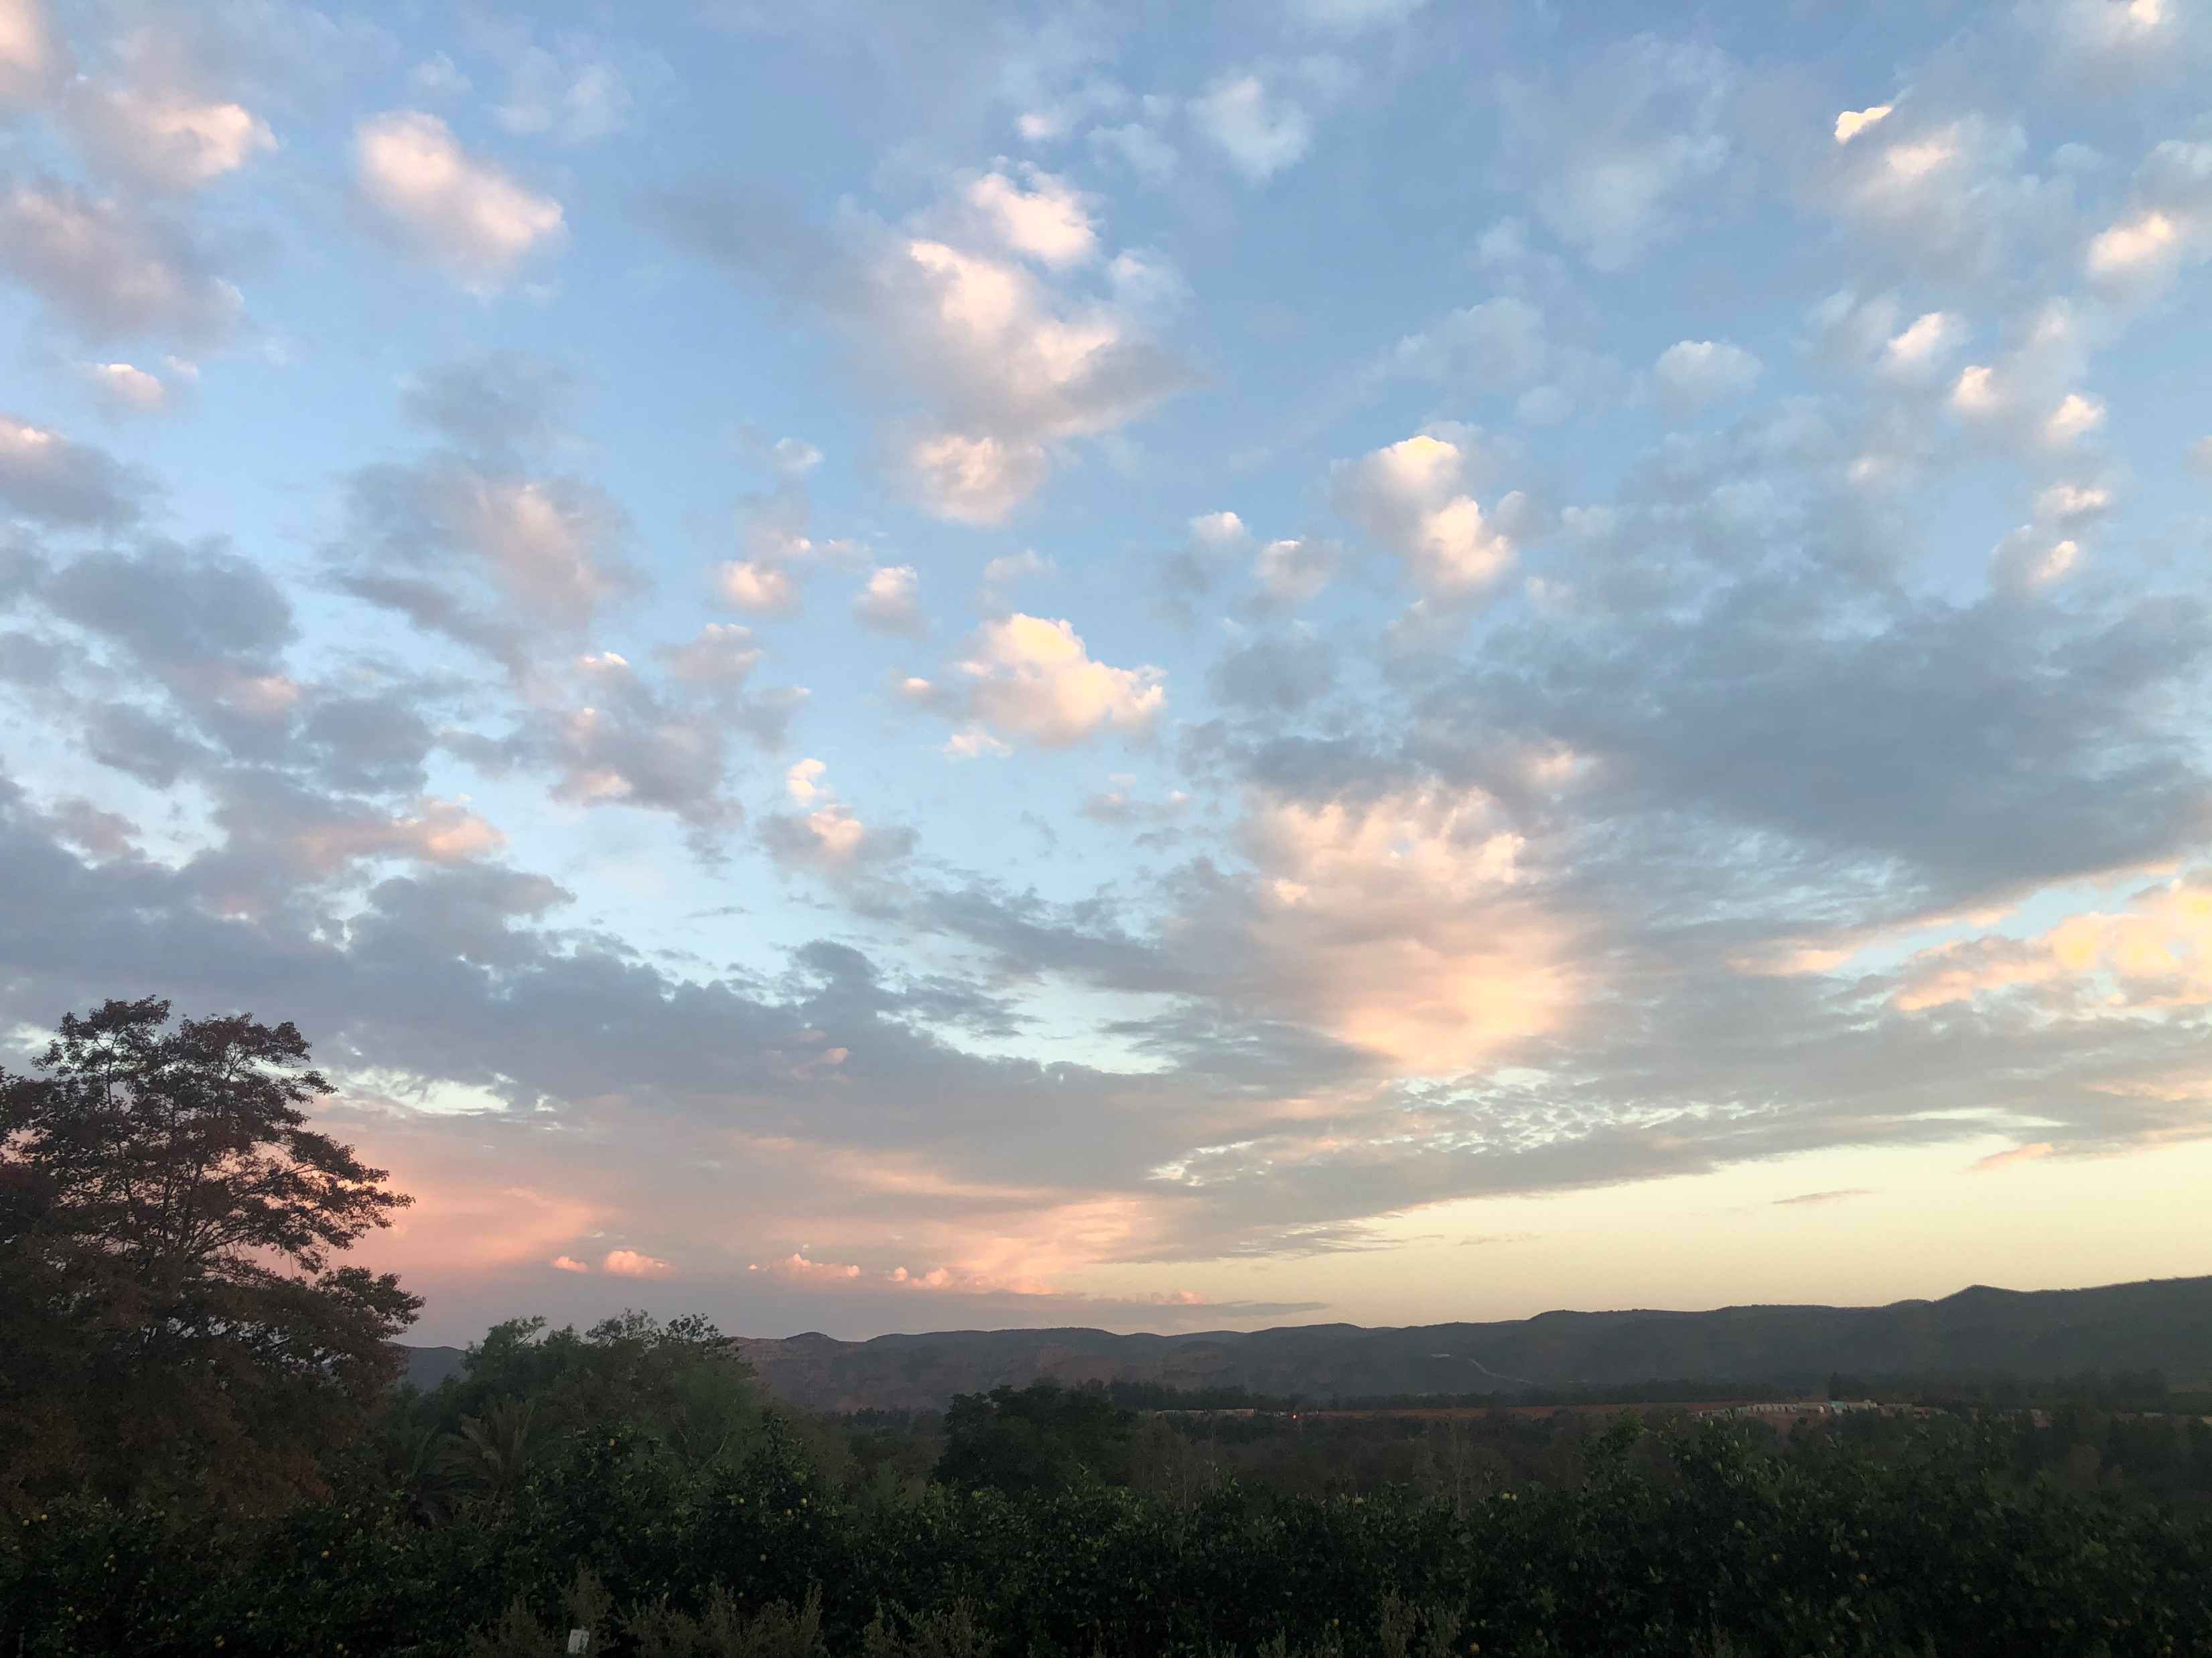
Gamtoos Valley and Baviaanskloof is a
fairly secluded and thus safe area to visit.
It is a Malaria free destination.
Best time to visit is all year round.
We want to assure all visitors & guests that
Covid regulations are adhered to by all tourism establishments.

Slide 30
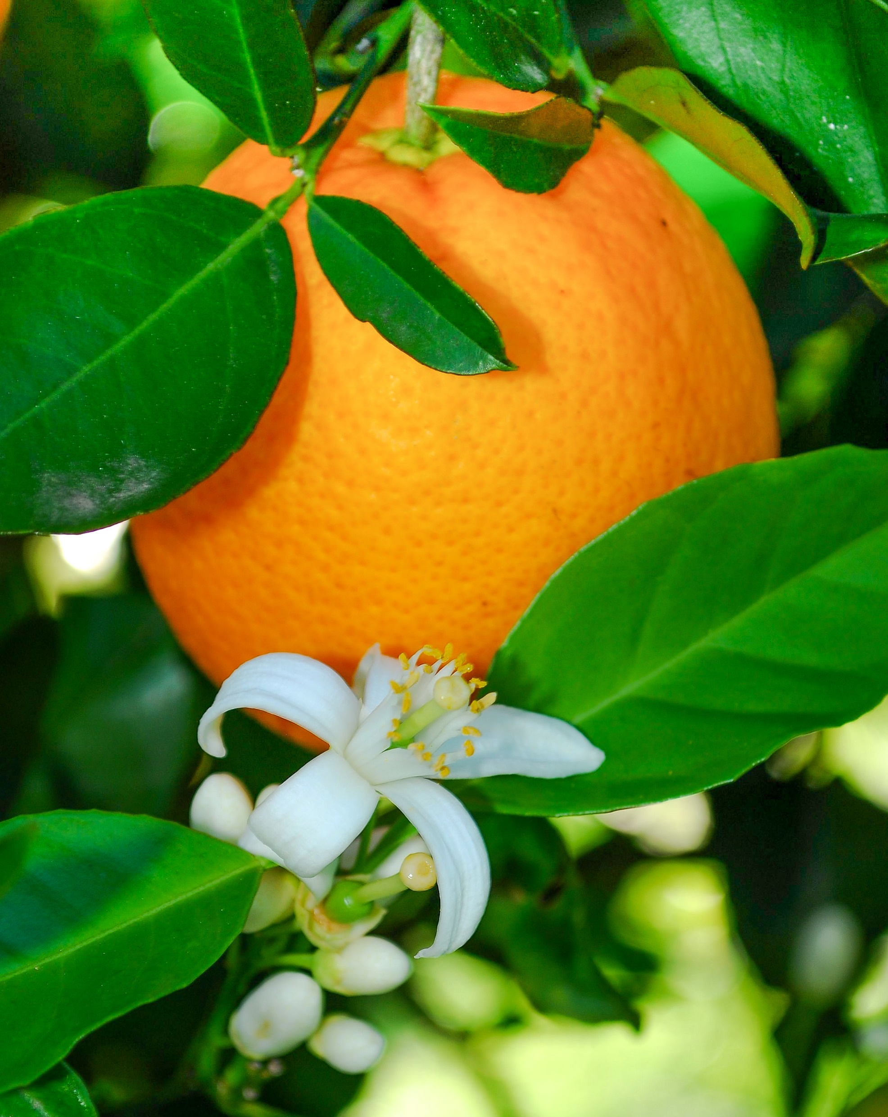
WE APPRECIATE YOUR TIME
For more information contact:
Gamtoos Tourism
E-mail: info@baviaans.net
Website: www.baviaans.net

